Slide 1






THE SCIENTIFIC CALCULATOR(GUI)
by Cubeiod Group

Slide 2

INTRODUCTION
Scientific calculators are essential tools in education and industry, particularly for solving complex mathematical and engineering problems. However, traditional calculators often lack interactivity and adaptability. This project aims to develop a Python-based scientific calculator with a user-friendly graphical user interface (GUI) using PyQt5. The calculator leverages object-oriented programming (OOP) principles such as inheritance, polymorphism, encapsulation, and abstraction, offering a modular and maintainable solution for advanced computations like calculus, trigonometry, kinematics, and numeral system conversions. It is designed to support engineering students and professionals in their computational tasks.

Slide 3

WHY WE MADE THE STUDY
The project was created to provide a more accessible, interactive, and efficient tool for solving complex mathematical problems. By addressing the limitations of traditional calculators, the study aims to improve learning and problem-solving, particularly in subjects such as calculus, physics, and geometry.

Slide 4
RELEVANCE OF THE STUDY
This study integrates modern computing capabilities with traditional calculator functionality through the use of object-oriented programming (OOP). OOP enhances the calculator's flexibility, scalability, and maintainability, allowing for future expansions. The project provides a precise, adaptable tool for engineering students, helping them tackle advanced mathematics and physics problems while demonstrating the power of OOP in software development.

Slide 5

STATEMENT OF THE PROBLEM
Statement of the Problem
Many students and professionals struggle with traditional calculators that lack interactivity, history tracking, and the ability to perform advanced computations. This project seeks to answer the following questions:
How can Python and PyQt5 be used to develop a comprehensive scientific calculator with advanced functionalities?
What are the advantages of using OOP principles (e.g., inheritance, encapsulation, and polymorphism) to create a scalable and maintainable calculator?
How can a GUI-based interface enhance the usability of the calculator for students and professionals?
How effective is the calculator in performing complex mathematical operations, ensuring accuracy and efficiency through OOP?

Slide 6

SCOPE AND DELIMITATION
Scope
Developed using Python and PyQt5, with a GUI for interactive use.
Includes features like basic arithmetic, trigonometric functions, calculus (differentiation and integration), physics calculations, geometry, numeral system conversions, complex numbers, and history tracking.
Target audience: Engineering students and professionals.
Delimitation
The calculator is a desktop application, primarily for Windows OS.
It does not include mobile or web-based versions or integration with external hardware.
It focuses on symbolic calculations within Python’s libraries, excluding hardware-based symbolic computation.

Slide 7
OBJECTIVES
Develop a Python-based scientific calculator with advanced functionalities.
Design a GUI using PyQt5 to enhance usability and interactivity.
Apply OOP principles to ensure modularity, maintainability, and scalability.
Include features such as:
Basic arithmetic, calculus, trigonometry, geometry, and physics-related functions
Numeral system conversions
Complex number operations and history tracking

Slide 8
METHODOLOGY
The scientific calculator was developed using Python and PyQt5. Object-oriented principles guided the design for modularity and scalability. Key steps included:
Requirements Analysis: Identifying user needs for advanced calculations.
System Design: Creating reusable and modular classes using OOP.
Implementation: Developing the GUI and integrating mathematical functions.
Testing: Conducting unit, integration, and performance tests to validate the tool’s functionality and user experience.

Slide 9
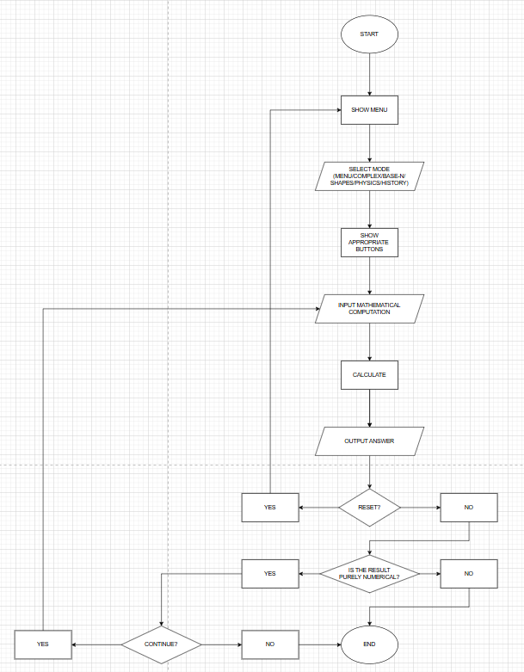

Slide 10
RESULTS
The scientific calculator successfully integrated:
A user-friendly GUI with seamless navigation for advanced functions.
Mathematical features such as factorials, permutations, combinations, base conversions, and trigonometry.
History tracking for calculations.
A robust architecture for future enhancements, with efficient performance for complex computations.

Slide 11
DISCUSSION
The project showcases how modern programming techniques and OOP principles can improve educational tools. The use of PyQt5 for the GUI enhances user interaction, making the tool suitable for academic and professional use. Limitations include its dependency on Python’s runtime and lack of hardware integration. Future improvements may include multi-platform support and additional scientific libraries.

Slide 12
CONCLUSION
The Python-based scientific calculator successfully addresses the limitations of traditional calculators by integrating advanced mathematical and engineering functions with an intuitive, user-friendly graphical user interface (GUI) developed using PyQt5. The project demonstrates the effective application of object-oriented programming (OOP) principles, such as inheritance, polymorphism, encapsulation, and abstraction, which ensure the calculator’s modularity, scalability, and maintainability. These principles allowed for easy extension and organization of complex functionalities, enabling the calculator to handle a wide range of operations, from basic arithmetic to advanced calculus, trigonometry, physics computations, and numeral system conversions.

Slide 13
CONCLUSION
In this project, we developed a Python-based scientific calculator that overcomes the limitations of traditional calculators by offering advanced features and a user-friendly GUI built with PyQt5. By applying object-oriented programming (OOP) principles like inheritance, polymorphism, and encapsulation, we ensured the calculator is modular, scalable, and easy to maintain.
The GUI makes the calculator accessible and intuitive for both students and professionals, while it effectively handles various mathematical operations, from basic arithmetic to advanced calculus and physics calculations, with accuracy and efficiency.
This project demonstrates the potential of Python, PyQt5, and OOP in creating a practical tool that meets the needs of engineering students, with room for future improvements and feature expansions.

Slide 14
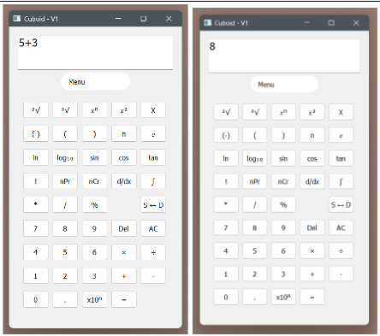
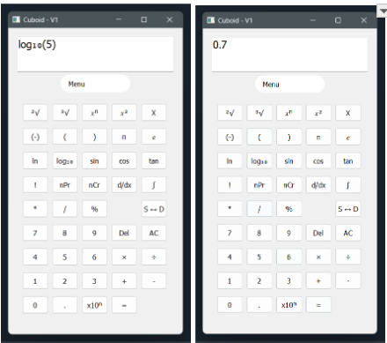
DOCUMENTION

Slide 15
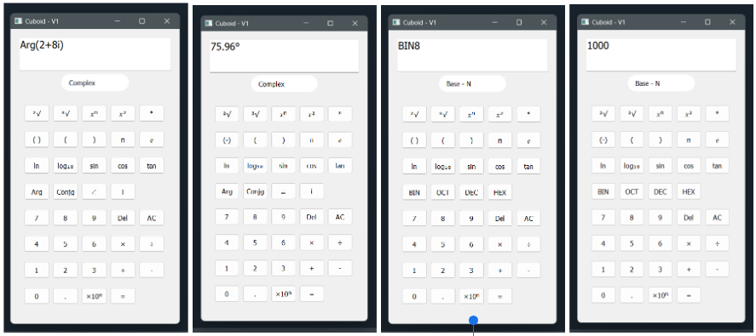
DOCUMENTION

Slide 16
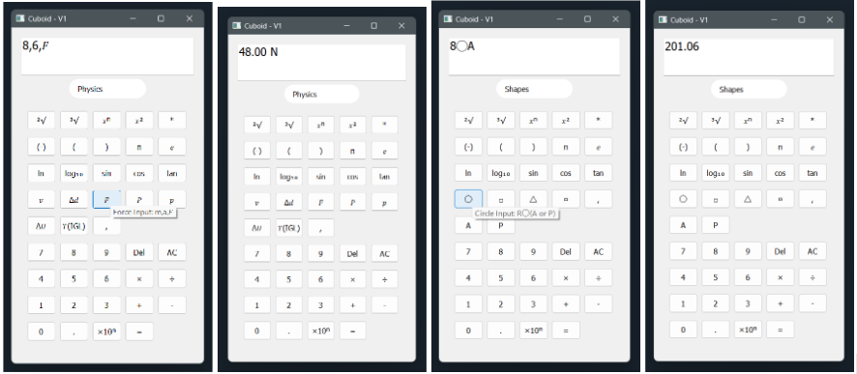
DOCUMENTION

Slide 17
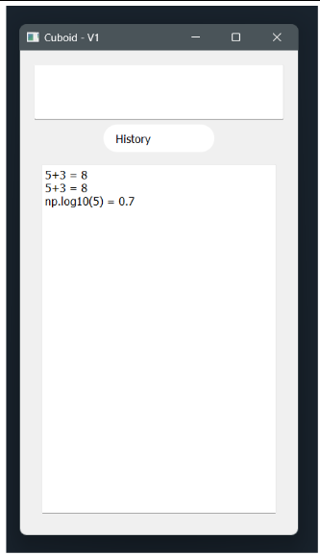
DOCUMENTION

Slide 18

THANK YOU

